Slide 1
“Kinect Fusion: HW Implementation and Acceleration of a Dense SLAM Algorithm” Final Report
ITRI EOSL Summer Intern Program
李承澔
NTHU EECS24 109020014

Slide 2
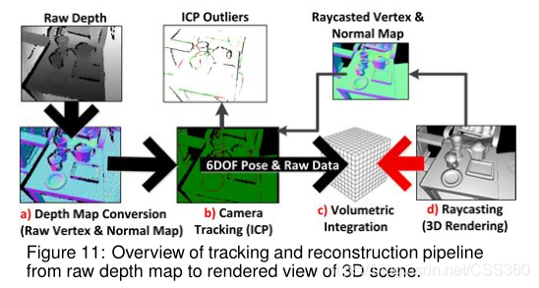
Kinect Fusion
Kinect Fusion is an algorithm that reconstructs a 3D environment from a depth map acquired either by a depth camera or a stereo camera setup
It follows the workflow:

Slide 3
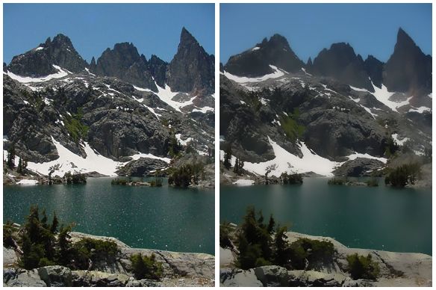
a) Depth Map Conversion – Bilateral Filter Kernel
The algorithm employs a bilateral filter to reduce noise in the input depth map. This filter uses a 5x5 sliding window.
Slide Window
Slide Window
Output Pixel
Output Pixel

Slide 4
a) Depth Map Conversion – Bilateral Filter Kernel Optimize
The use of a 5x5 sliding window results in numerous read operations—25 memory read operations for each pixel computation, exactly.
To mitigate this, we have implemented line and window buffers in hardware to cache pixels and reduce the number of read operations per pixel computation.
Window Buffer
Line Buffer 1
Line Buffer 2
Line Buffer 3
Line Buffer 4
Line Buffer 5
Output Pixel
Input Pixel Stream

Slide 5
a) Depth Map Conversion – Half Sample Kernel
After filtering, Kinect Fusion constructs a scale pyramid and prepares scaled-down depth maps for subsequent vertex and normal computations.
Scaled Depth
Level 2
Scaled Depth
Level 1
Scaled Depth
Level 0

Slide 6
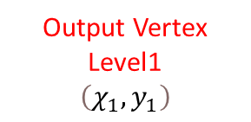


a) Depth Map Conversion – Depth 2 Vertex
Kinect Fusion traverses all three scaled depth maps to produce three sets of vertices.
Output Vertex
Level2
$$\left(χ_{2},y_{2}\right)$$
Output Vertex
Level1
$$\left(χ_{1},y_{1}\right)$$
Output Vertex
Level0
$$\left(χ_{0},y_{0}\right)$$
Scaled Depth
Level 2
Scaled Depth
Level 1
If the depth of the target pixel exceeds a predefined threshold, the pixel is annotated as a vertex
Scaled Depth
Level 0

Slide 7
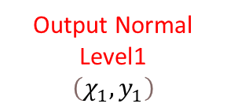


a) Depth Map Conversion – Vertex 2 Normal
The algorithm also traverses all three scaled vertex maps to produce three sets of normals.
Output Normal
Level2
$$\left(χ_{2},y_{2}\right)$$
Output Normal
Level1
$$\left(χ_{1},y_{1}\right)$$
Output Normal
Level0
$$\left(χ_{0},y_{0}\right)$$
Scaled Vertex
Level 2
Scaled Vertex
Level 1
It first examines the neighbors (up, down, left, right) of the target pixel,
and then computes the pixel's normal
Scaled Vertex
Level 0

Slide 8
a) Depth Map Conversion – Half Sample Depth 2 Vertex Optimize
Since Kinect Fusion first generates scaled depth maps and then traverses each one to produce vertices, these two operations can be merged.
We read a 4x4 block of pixels and leverage parallel computing resources to calculate the next-level depth and its corresponding vertex.
Stage0
Stage1
Stage2
Cache a 4x4
block of depth
Scaled down
Scaled down
To Vertex
To Vertex
To Vertex
Input Depth
Output Vertex Level 0
Output Vertex Level 1
Output Vertex Level 2

Slide 9
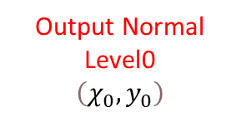

a) Depth Map Conversion – Vertex 2 Normal Optimize
Since the vertex-to-normal conversion also utilizes a sliding window to consider the neighboring pixels of the target and compute normals, we continue to apply line and window buffer techniques to cache pixels.
Output Normal
Level2
$$\left(χ_{2},y_{2}\right)$$
Output Normal
Level1
$$\left(χ_{1},y_{1}\right)$$
Output Normal
Level0
$$\left(χ_{0},y_{0}\right)$$
Scaled Vertex
Level 2
Window Buffer
Scaled Vertex
Level 1
Line Buffer 1
Line Buffer 2
Line Buffer 3
Output Normal
Scaled Vertex
Level 0
Input Pixel Stream

Slide 10
b) Camera Tracking – ICP Algorithm
Kinect Fusion traverses all pixels and matches vertices based on their depth and normal.
The algorithm employs an iterative approach to solve a least-squares problem, ultimately yielding the camera's transformation matrix.
Vertex and Normal at time i-1
ICP outliers at time i-1
least-squares problem
Transformation
Matrix
Vertex and Normal at time i
ICP outliers at time i

Slide 11
b) Camera Tracking – ICP Algorithm Optimize
Given that the tracking algorithm demands substantial computational resources,
we have divided it into multiple stages and pipelined them to achieve an initiation interval (II) of 1.
Normal validation
Projection of the current vertex onto camera coordinates
Validation of the corresponding vertex to the current one at time
i−1
Assessment of whether the distance between vertices is below a threshold
Evaluation of whether the included angle between normals is below a threshold
Matching of two vertices and solving a least-squares problem to obtain the transformation matrix

Slide 12
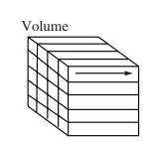
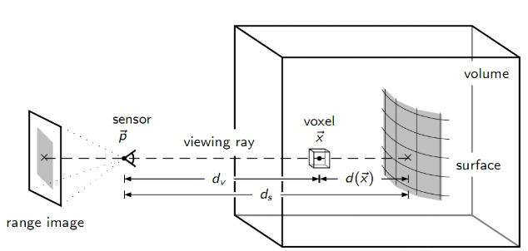
c) Volumetric Integration
Kinect Fusion updates the 3D voxels based on the current camera position and vertex depth. The algorithm performs the following steps:
Traverses a row of voxels along the
z-axis at time i
Transforms the voxel through the coordinate transformation:
global → camera → image
Updates the entire row of voxels based on the pixel depth,
which is transformed from the voxel

Slide 13
c) Volumetric Integration - Optimization
Given that the integration traverses all voxels in the 3D space, resulting in heavy computation, we deploy two compute units to parallelly process two rows of voxels along the z-axis.
Compute unit 1
Compute unit 2

Slide 14
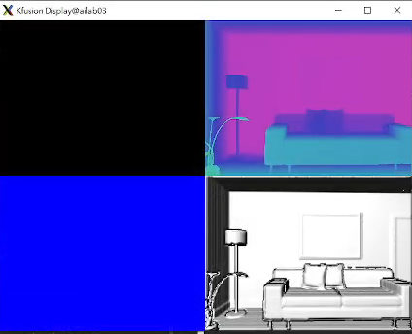
Result and Compare – Reconstruction Process

Slide 15
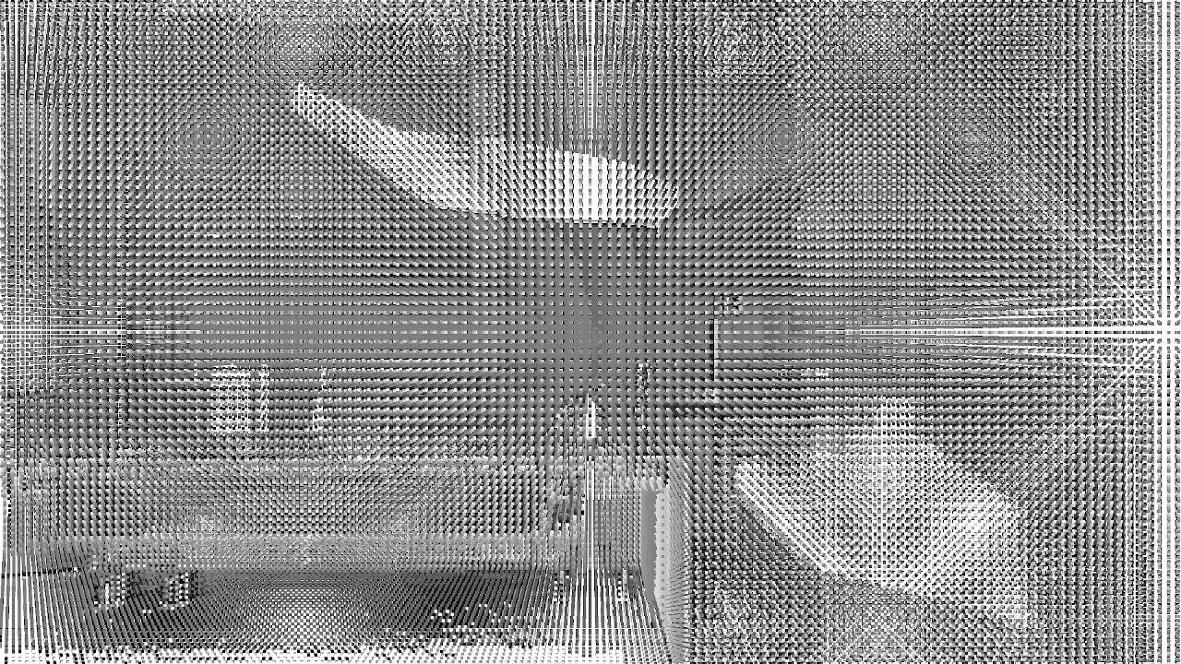
Result and Compare – Volumetric Reconstruction

Slide 16
Result and Compare
SW : Intel(R) Xeon(R) E-2288G CPU @ 3.70GHz OpenMP disable
HW : AMD Alveo™ U50 FPGA
Kernel Average Latency(ms) | Bilateral Filter Kernel | Half Sample Kernel | Depth2 Vertex Kernel | Vertex2 Normal Kernel | Track Kernel | Integrate Kernel | Error (ATE)
SW | 26.504 | 36.602 | 53.494 | 51.648 | 584.756 | 10.841 | 18.069
HW Baseline | 43.374 | 31.789 |  | 0.738 | 498.939 | 3149 | 17.280
HW Optimize | 0.516 | 31.789 |  | 0.541 | 1.236 | 29.470 | 17.280

Slide 17
Result and Compare
Resource Usage &Timing |  | Bilateral Filter Kernel | HalfSample 2Vertex Kernel | Vertex2 Normal Kernel | Track Kernel | Integrate Kernel
Frequency (MHz) | baseline | 379.794 | 379.794 | 411.015 | 348.918 | 351.370
 | optimize | 411.015 | 379.794 | 411.015 | 327.332 | 411.015
II | baseline | =1 | =1 | violation | =1 | =1
 | optimize | =1 | =1 | =1 | =1 | =1
BRAM (%) | baseline | 0 | 0 | 0 | 0 | 0
 | optimize | 0 | 0 | 0 | 4 | 16
DSP (%) | baseline | ~0 | ~0 | ~0 | ~0 | ~0
 | optimize | 1 | ~0 | ~0 | 1 | 4
FF (%) | baseline | ~0 | ~0 | ~0 | 4 | 1
 | optimize | 1 | ~0 | ~0 | 2 | 3
LUT (%) | baseline | 1 | 3 | 1 | 24 | 3
 | optimize | 5 | 3 | 2 | 3 | 6

